Slide 1
GRU Networks
https://blog.floydhub.com/gru-with-pytorch/

Slide 2
GRU (Gated Recurrent Unit)
GRU (Gated Recurrent Unit) aims to solve the vanishing gradient problem which comes with a standard recurrent neural network.
GRU can also be considered as a variation on the LSTM because both are designed similarly and, in some cases, produce equally excellent results.

Slide 3
How do GRUs work?
As mentioned above, GRUs are improved version of standard recurrent neural network. But what makes them so special and effective?
To solve the vanishing gradient problem of a standard RNN, GRU uses, so-called, update gate and reset gate.
Basically, these are two vectors which decide what information should be passed to the output.
The special thing about them is that they can be trained to keep information from long ago, without washing it through time or remove information which is irrelevant to the prediction.
To explain the mathematics behind that process we will examine a single unit from the following recurrent neural network:

Slide 4
What is a Gated Recurrent Unit?
A gated recurrent unit (GRU) is a gating mechanism in recurrent neural networks (RNN) similar to a long short-term memory (LSTM) unit but without an output gate. GRU’s try to solve the vanishing gradient problem that can come with standard recurrent neural networks.
A GRU can be considered a variation of the long short-term memory (LSTM) unit because both have a similar design and produce equal results in some cases. GRU’s are able to solve the vanishing gradient problem by using an update gate and a reset gate.
The update gate controls information that flows into memory, and the reset gate controls the information that flows out of memory.
The update gate and reset gate are two vectors that decide which information will get passed on to the output.
They can be trained to keep information from the past or remove information that is irrelevant to the prediction.
Why is this Useful?
A GRU is a very useful mechanism for fixing the vanishing gradient problem in recurrent neural networks.
The vanishing gradient problem occurs in machine learning when the gradient becomes vanishingly small, which prevents the weight from changing its value. They also have better performance than LSTM when dealing with smaller datasets.
Applications of a Gated Recurrent Unit
Polyphonic music modeling
Speech signal modeling
Handwriting recognition

Slide 5
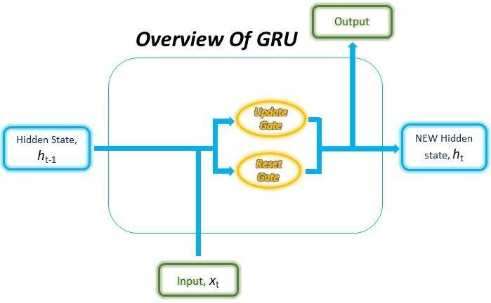
GRU (Gated Recurrent Unit)
Overall structure within the GRU cell

Slide 6
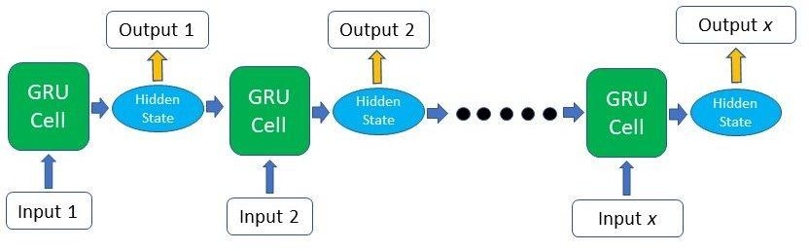
GRU (Gated Recurrent Unit)
The structure of the GRU allows it to adaptively capture dependencies from large sequences of data without discarding information from earlier parts of the sequence.
This is achieved through its gating units, similar to the ones in LSTMs, which solve the vanishing/exploding gradient problem of traditional RNNs.
These gates are responsible for regulating the information to be kept or discarded at each time step.

Slide 7
But How Does It Really Work? Inner Workings of the GRU
The ability of the GRU to hold on to long-term dependencies or memory stems from the computations within the GRU cell to produce the hidden state.
While LSTMs have two different states passed between the cells — the cell state and hidden state, which carry the long and short-term memory, respectively — GRUs only have one hidden state transferred between time steps.
This hidden state is able to hold both the long-term and short-term dependencies at the same time due to the gating mechanisms and computations that the hidden state and input data go through.

Slide 8
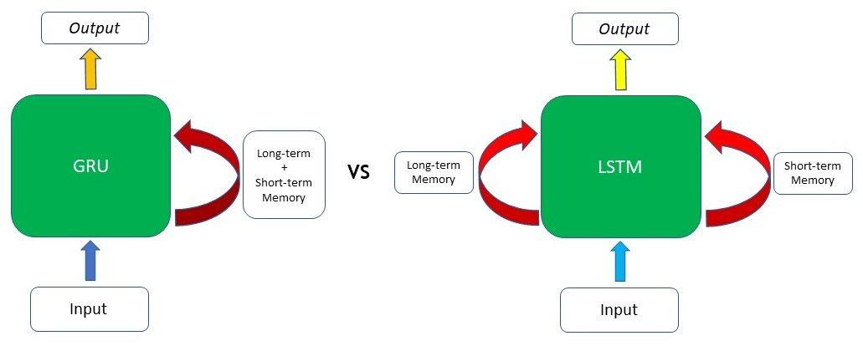

Slide 9
GRU
The GRU cell contains only two gates: the Update gate and the Reset gate. Just like the gates in LSTMs, these gates in the GRU are trained to selectively filter out any irrelevant information while keeping what’s useful.
These gates are essentially vectors containing values between 0 to 1 which will be multiplied with the input data and/or hidden state.
A 0 value in the gate vectors indicates that the corresponding data in the input or hidden state is unimportant and will, therefore, return as a zero.
On the other hand, a 1 value in the gate vector means that the corresponding data is important and will be used.

Slide 10
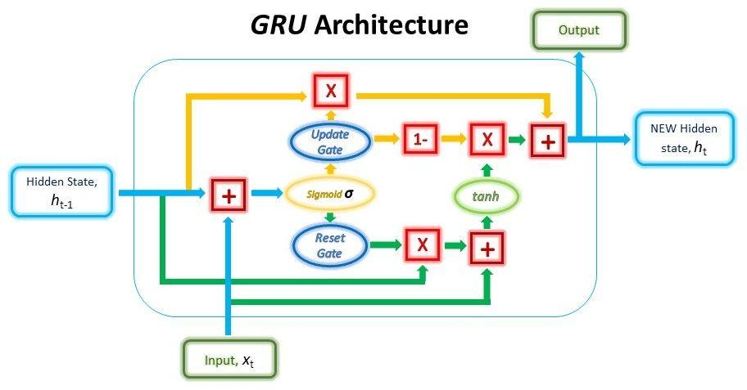
The structure of a GRU unit is shown below.

Slide 11
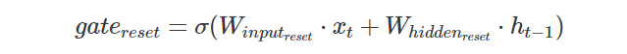
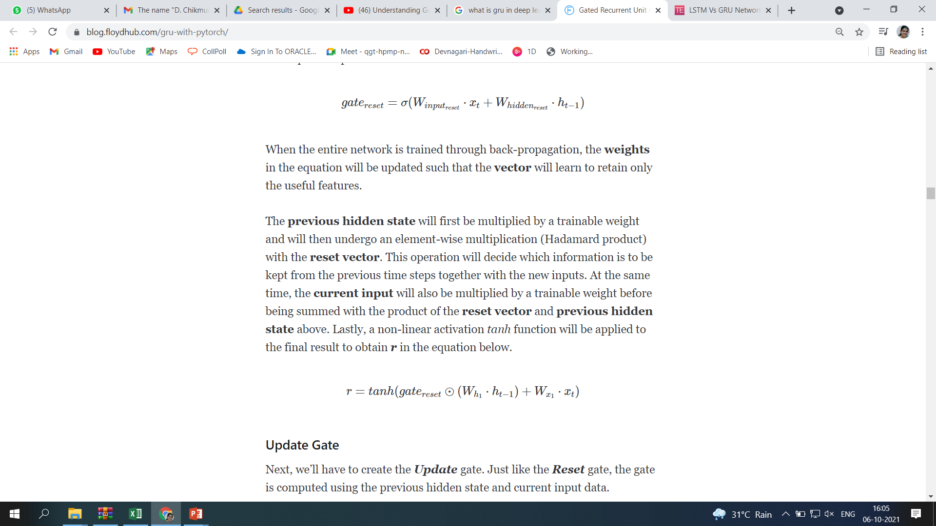
Reset Gate
In the first step, we’ll be creating the Reset gate. This gate is derived and calculated using both the hidden state from the previous time step and the input data at the current time step.
Mathematically, this is achieved by multiplying the previous hidden state and current input with their respective weights and summing them before passing the sum through a sigmoid function. The sigmoid function will transform the values to fall between 0 and 1, allowing the gate to filter between the less-important and more-important information in the subsequent steps.
When the entire network is trained through back-propagation, the weights in the equation will be updated such that the vector will learn to retain only the useful features.
The previous hidden state will first be multiplied by a trainable weight and will then undergo an element-wise multiplication (Hadamard product) with the reset vector.
This operation will decide which information is to be kept from the previous time steps together with the new inputs. At the same time, the current input will also be multiplied by a trainable weight before being summed with the product of the reset vector and previous hidden state above. Lastly, a non-linear activation tanh function will be applied to the final result to obtain r in the equation below.

Slide 12
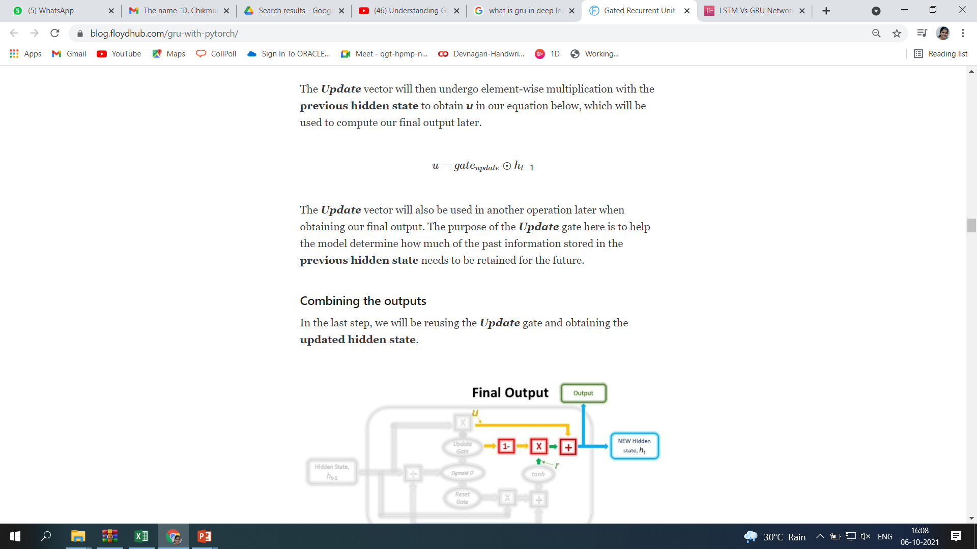
Update Gate
Just like the Reset gate, the gate is computed using the previous hidden state and current input data.
The Update vector will then undergo element-wise multiplication with the previous hidden state to obtain u in our equation below, which will be used to compute our final output later.
The Update vector will also be used in another operation later when obtaining our final output.
The purpose of the Update gate here is to help the model determine how much of the past information stored in the previous hidden state needs to be retained for the future.

Slide 13
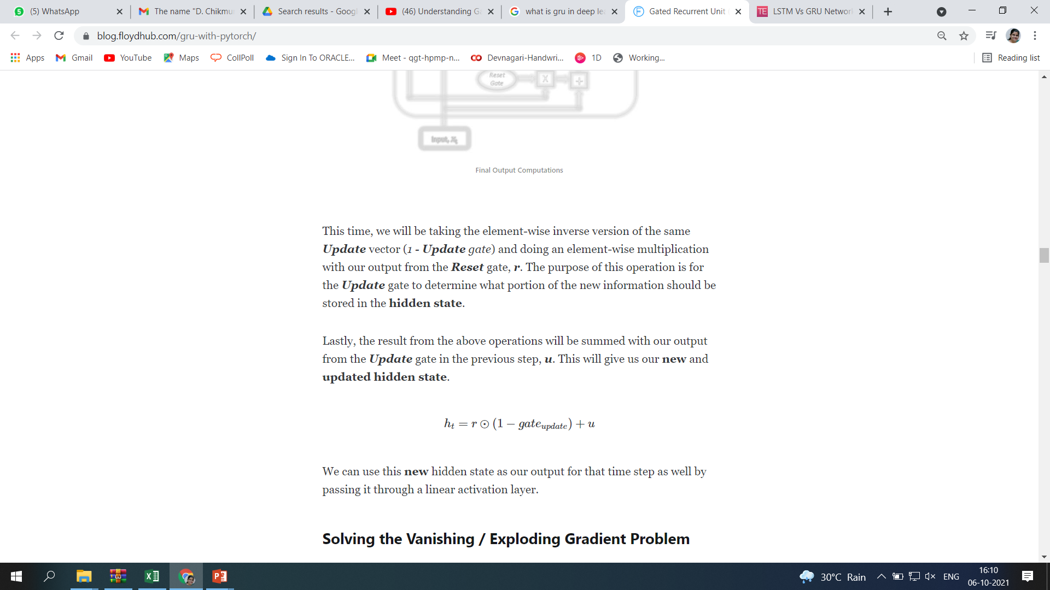
Combining the outputs
In the last step, we will be reusing the Update gate and obtaining the updated hidden state.
This time, we will be taking the element-wise inverse version of the same Update vector (1 - Update gate) and doing an element-wise multiplication with our output from the Reset gate, r.
The purpose of this operation is for the Update gate to determine what portion of the new information should be stored in the hidden state.
Lastly, the result from the above operations will be summed with our output from the Update gate in the previous step, u. This will give us our new and updated hidden state.
We can use this new hidden state as our output for that time step as well by passing it through a linear activation layer.

Slide 14
Solving the Vanishing / Exploding Gradient Problem
As we’ve seen in the mechanisms above, the Reset gate is responsible for deciding which portions of the previous hidden state are to be combined with the current input to propose a new hidden state.
And the Update gate is responsible for determining how much of the previous hidden state is to be retained and what portion of the new proposed hidden state (derived from the Reset gate) is to be added to the final hidden state.
When the Update gate is first multiplied with the previous hidden state, the network is picking which parts of the previous hidden state it is going to keep in its memory while discarding the rest.
Subsequently, it is patching up the missing parts of information when it uses the inverse of the Update gate to filter the proposed new hidden state from the Reset gate.

